Slide 1

Note: The data and information in this document is reflective of a hypothetical situation and client. This document is to be used for KPMG Virtual Internship purposes only.
Sprocket Central Pty Ltd
Data analytics approach
Faheem Shaikh

Slide 2
Agenda
Introduction
Data Exploration
Model Development
Interpretation

Slide 3
Objective
Identify and Recommend Top 1000 Customer to Target From Dataset
Sprocket Central Pty Ltd is a company specialized in high-quality bikes and accessible cycling accessories to riders. Using the 3 Dataset provided the aim is to analyze and recommend 1000 customers that company should Target to drive higher value for the company.
Topic Covered : -
New And Old Customer Age Distributions
Job Industry Distribution
Wealth Distribution By Age
Bike Related Purchases Over Last 3 Years By Gender
No. Of Cars Owned And Not Owned By State
RFM Analysis And Customer Classification
This will be done with three phases of : Data Exploration, Model Development and Interpretation.

Slide 4
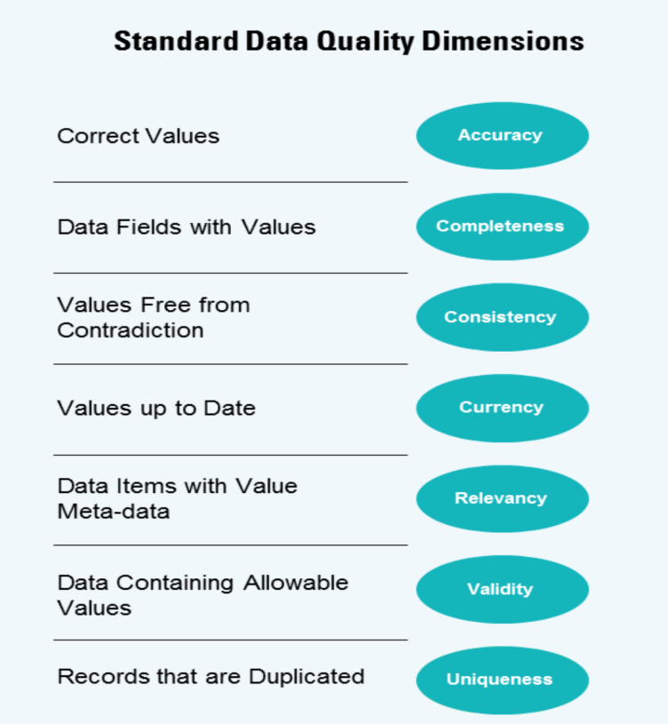
Data Exploration
Data Quality Assessment
 | Customer Demographic | Customer Address | Transactions
Accuracy | DOB: inaccurate | Property Value is different format
Completeness | Job Title : Blank |  | Profit Missing,Online Order blank, Brand blank
Consistency | Gender Inconsistency | State Inconsistency
Currency | Deceased Customers filter out
Relevancy |  |  | Cancelled Status :Filter Out
Validity |  |  | List Price: format, Product date format
Uniqueness | Customer ID

Slide 5
Data Exploration
New And Old Customer Age Distributions
It is Observed that most customers are aged between 40-49 in the ‘New Customer Distribution’ as well as ‘Old Customer Distribution’.
The ‘New Customer Distribution’ implies 20-29 and 40-69 is most populated where as under 20 and 80+ being lowest.
The ‘Old Customer Distribution’ suggests that 20-69 is most populated where as under 20 and 80+ being lowest.

Slide 6
Data Exploration
Job Industry Distribution
Almost 49% are from Manufacturing and Financial Services among ‘New Customer’.
Almost 47% are from Manufacturing and Financial Services among ‘Old Customer’.
The Smallest percentage of customers are from Agriculture and Telecommunications for both types of customers.

Slide 7
Data Exploration
Wealth Segmentation By Age
Wealth distribution is most among the age group 40-49.
In all the age category ‘Mass Customer’ are largest number of Customer.
Age group below 20 are with less Wealth distribution.

Slide 8
Data Exploration
Bike Related Purchases Over Last 3 Years By Gender
Over the last 3 Years about 50% of bike related purchases were made by Females to 48% made by Males. And approx 2% made by unknown gender.
Females made up majority of bike related sales. Hence, can be our target customer

Slide 9
Data Exploration
No. Of Cars Owned And Not Owned By State
NSW has the largest number of people that don’t have car. NSW seems to have highest number of people that have Car.
VIC also has decent number of people with no car.

Slide 10
Data Exploration
RFM Analysis And Customer Classification
RFM (Recency, Frequency and Monetary) Analysis is used to decide which customer base a business should target to increase its Revenue.
Gold and Platinum level shows customers that have displayed high level of engagement with the business.
Bronze level shows customers that can be lost.

Slide 11
Model Development
Customer Category with RFM values
Rank | Customer Category | Description | RFM Value
1 | Platinum Customer | Recent Buying , Buys Frequently, Most Spent | 412 - 444
2 | Gold Customer | Relatively Recent, Bought more than once, Spend decent money | 312 - 411
3 | Silver Customer | No Recent purchase, but RFM value is greater than average | 212 – 311
4 | Bronze Customer | Purchase was long time ago, low frequency, less amount spent | 111 - 211

Slide 12
Interpretation
SUMMARY
Filter through by assigning the condition discussed in the slides above.
Top 1000 potential Customers could possibly be among :-
1. Age group 40 – 79.
2. Mostly Female.
3. From Manufacturing and Financial Sector.
4. Mass Customer.
5. Doesn’t own a car and NSW is a possible candidate.
Rank | Customer Category | No. of Customer | Selection
1 | Platinum Customer | 786 | 786
2 | Gold Customer | 875 | 214

Slide 13
Note: The data and information in this document is reflective of a hypothetical situation and client. This document is to be used for KPMG Virtual Internship purposes only.
Appendix

